Slide 1

StacerBot: A Stacktrace Search Engine for Stack Overflow
Md Abdullah Al Alamin
Master’s Student at Department of Electrical and Software Engineering (ESE)
619_3 Advance Data Analytics

Slide 2
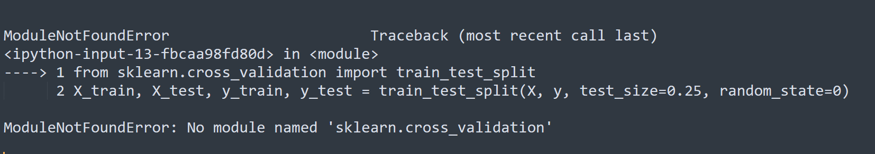

Slide 3
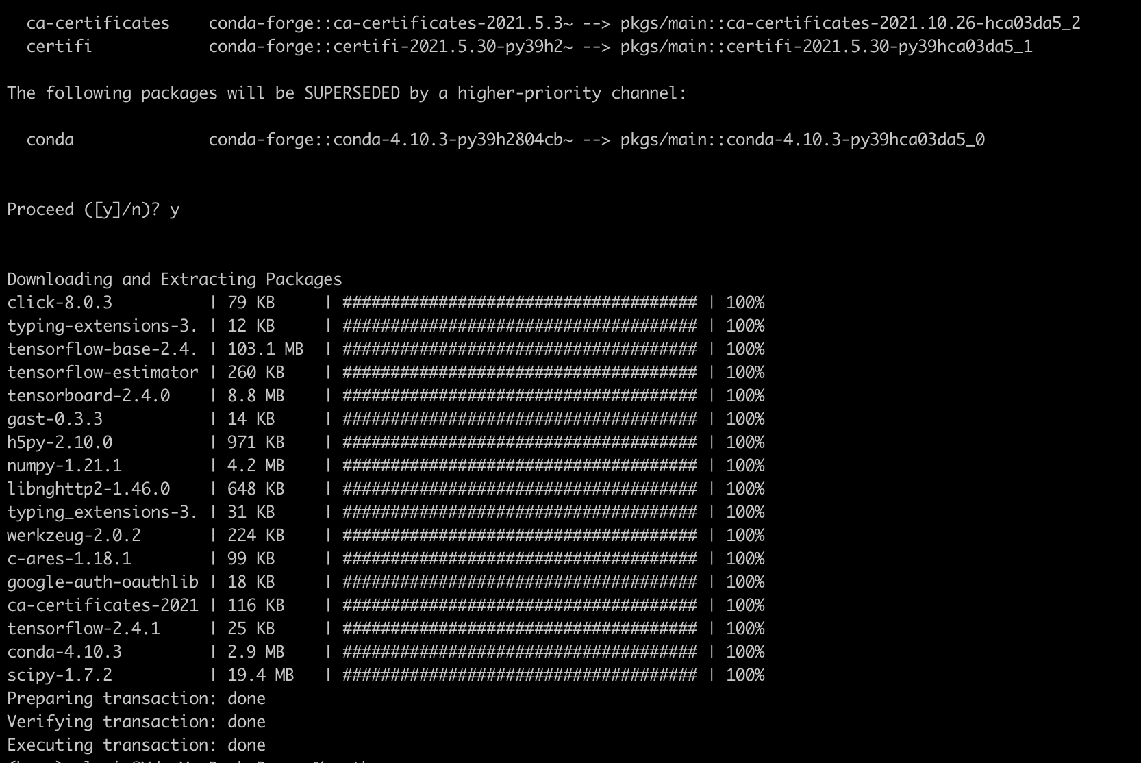

Slide 4
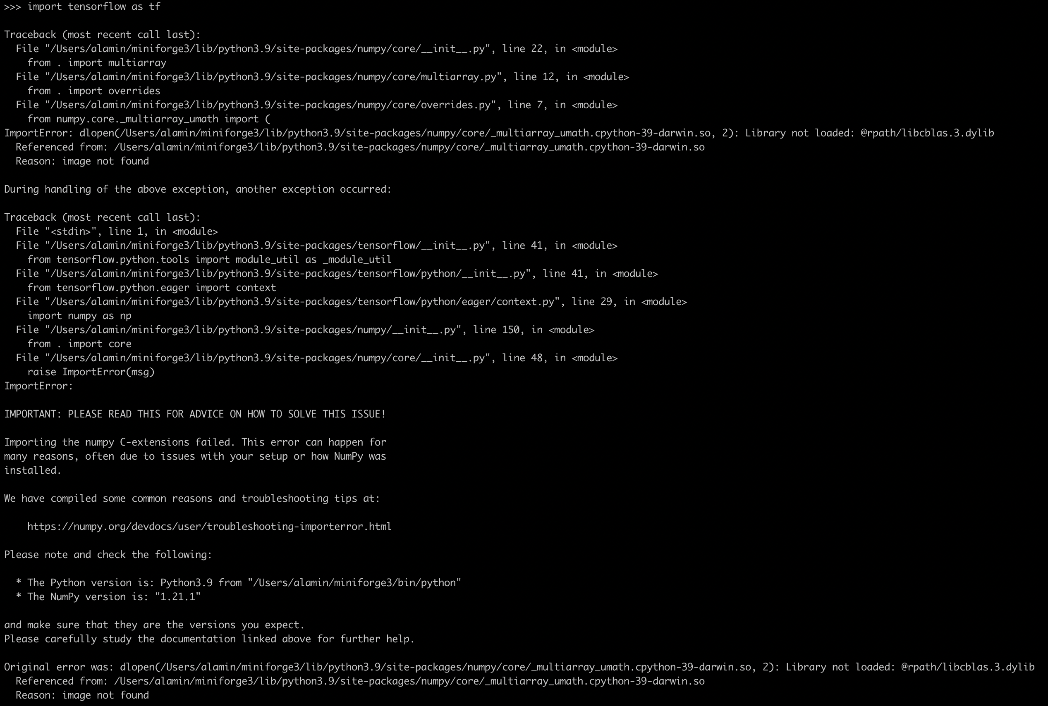


Slide 5
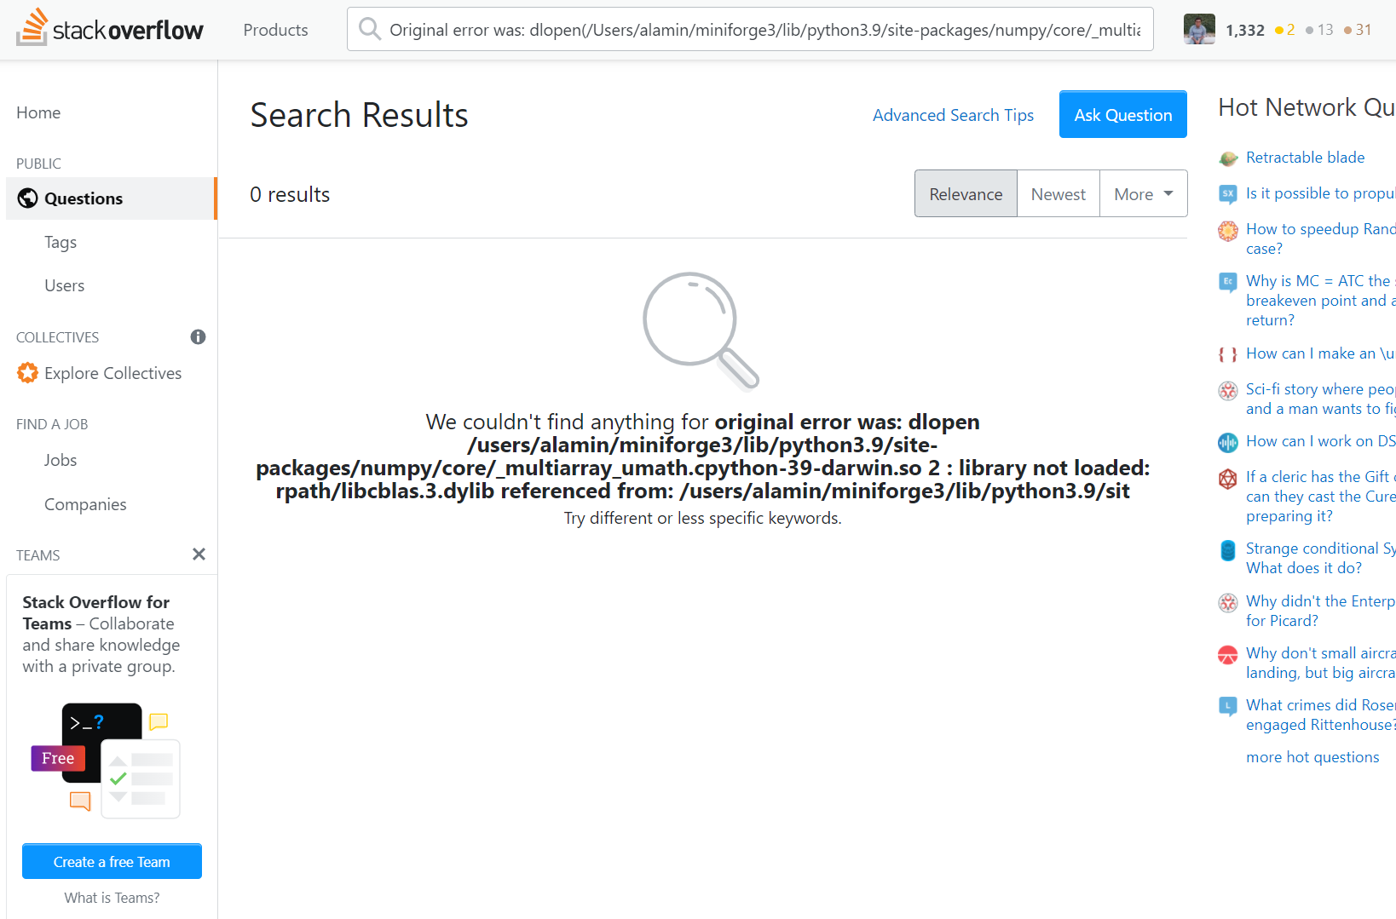

Slide 6
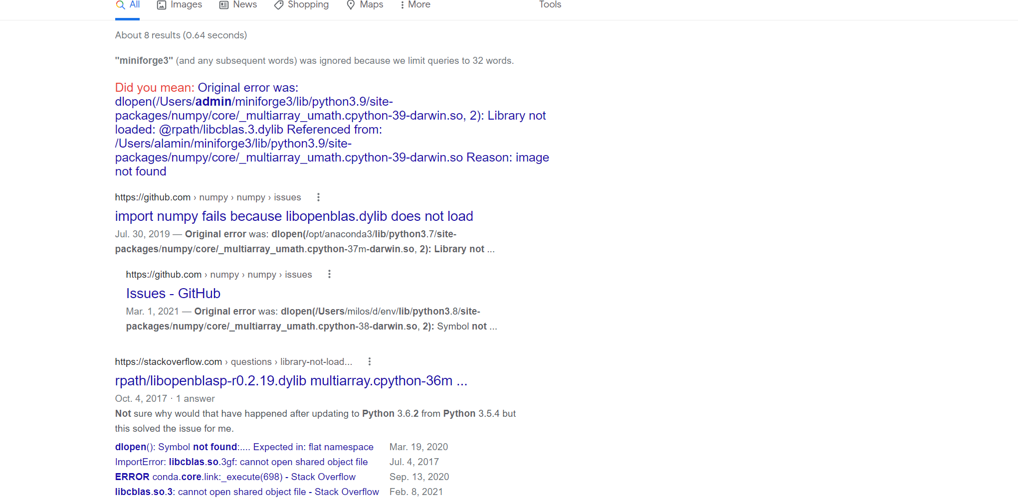

Slide 7
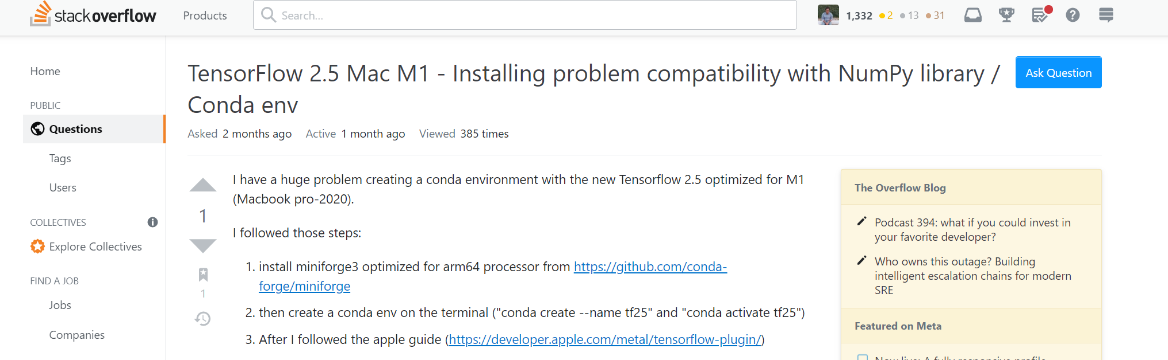
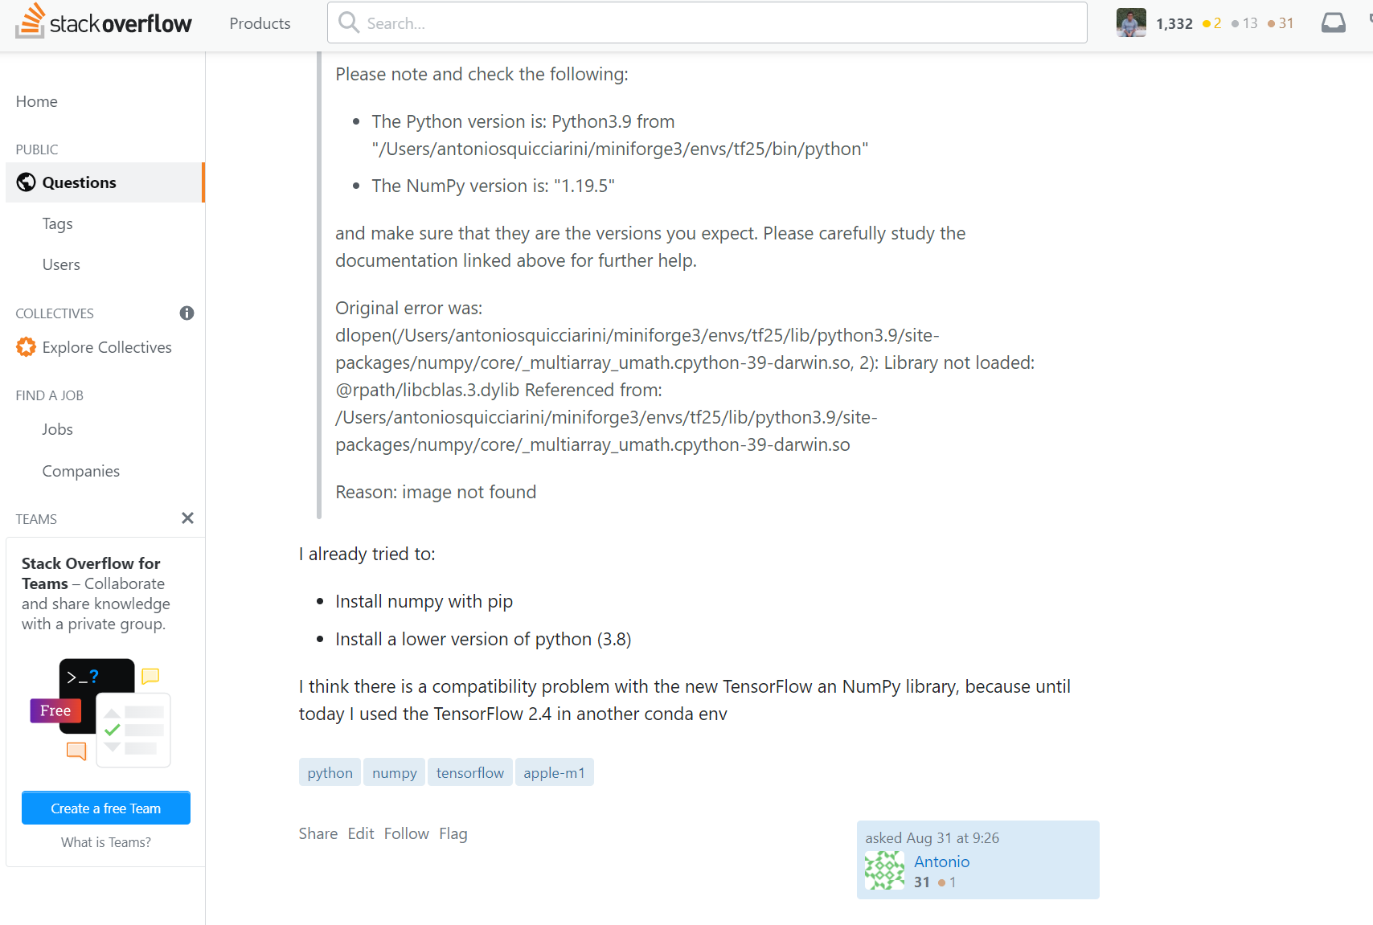

Slide 8
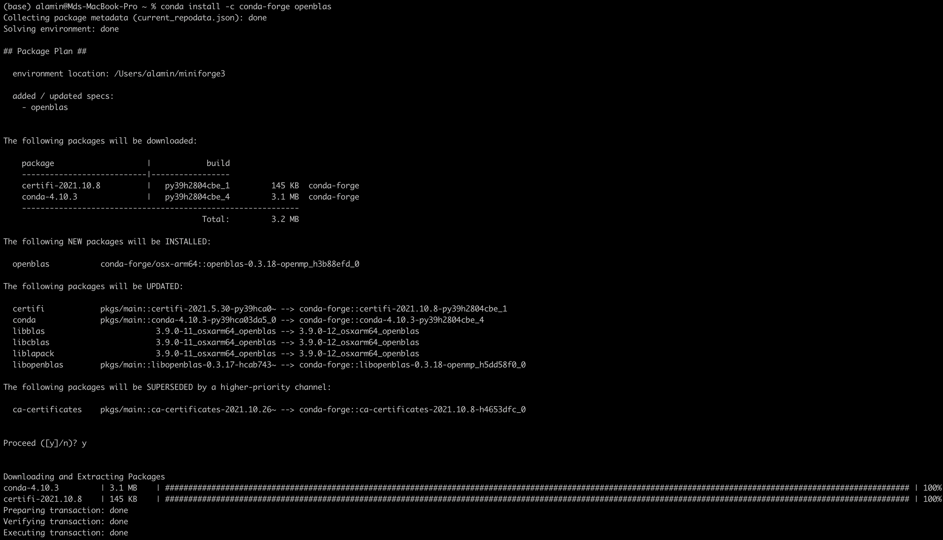
Conda install –c conda-forge openblas

Slide 9
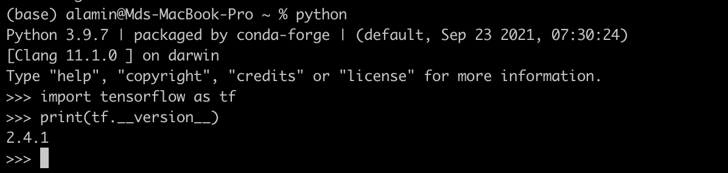

Slide 10
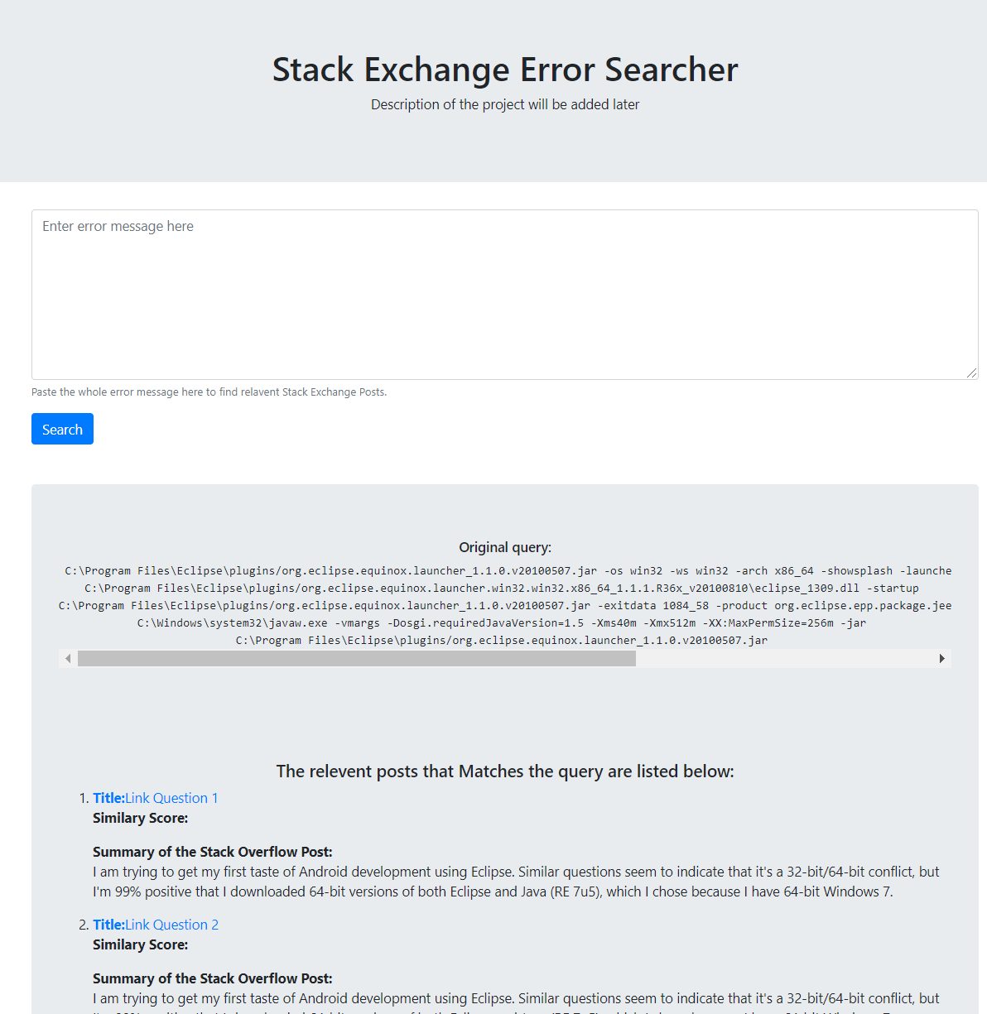
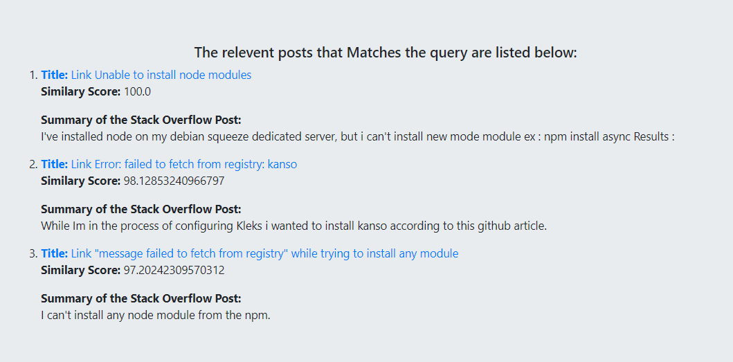
Final Output

Slide 11
Dataset Overview
SODump

Slide 12
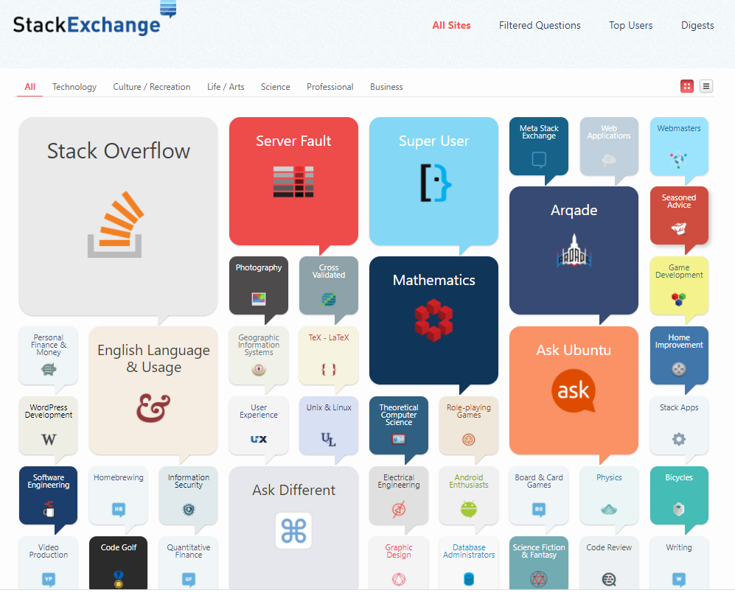
Dataset
170+ websites (Stack Overflow and others)
800M page views/Month
3M Questions/Month

Slide 13
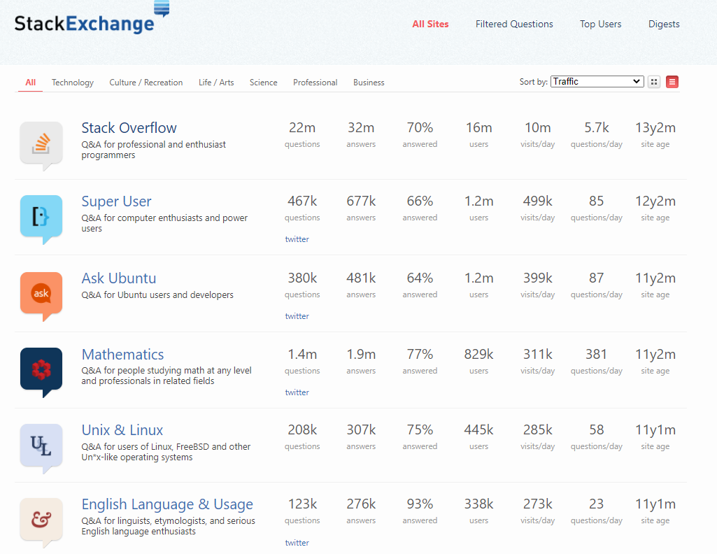
Dataset
50M developers per month

Slide 14
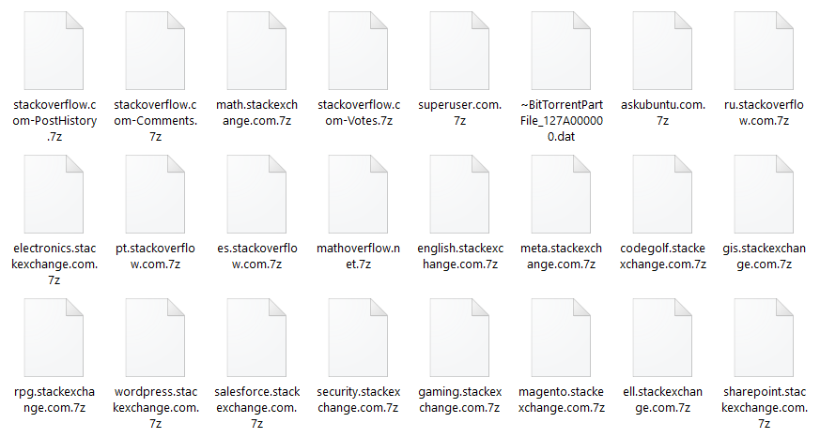
Dataset

Slide 15
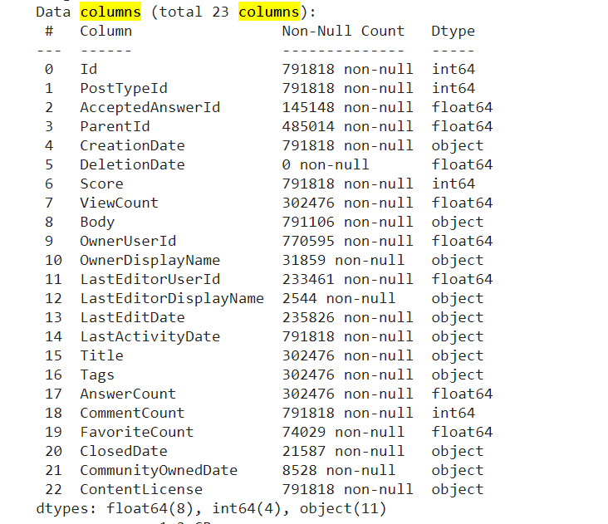

Slide 16

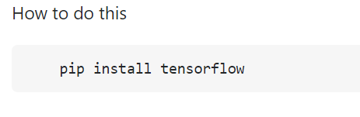
Stack Overflow Posts
Post Body
Data from the CSV file
Corresponding data in CSV file
<p> How to do this </p>
<code> pip install tensorflow </code>

Slide 17
Project overview

Slide 18
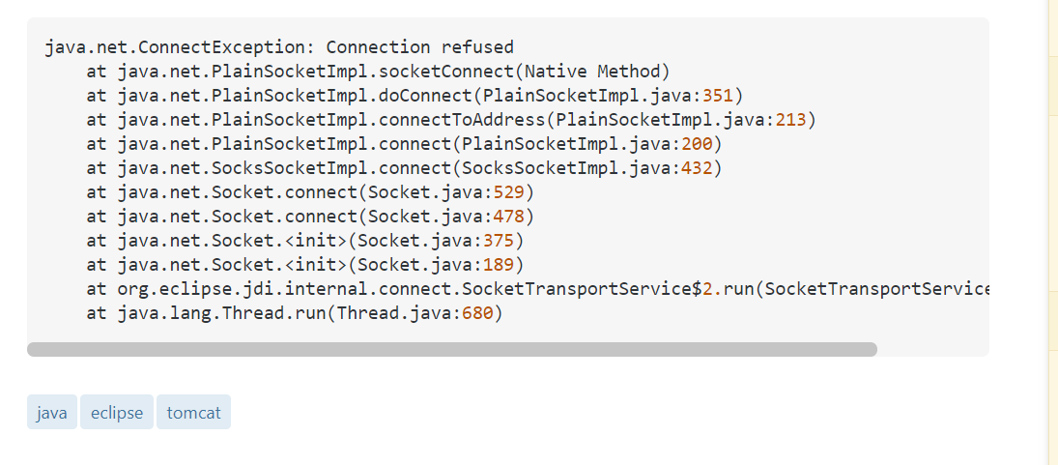
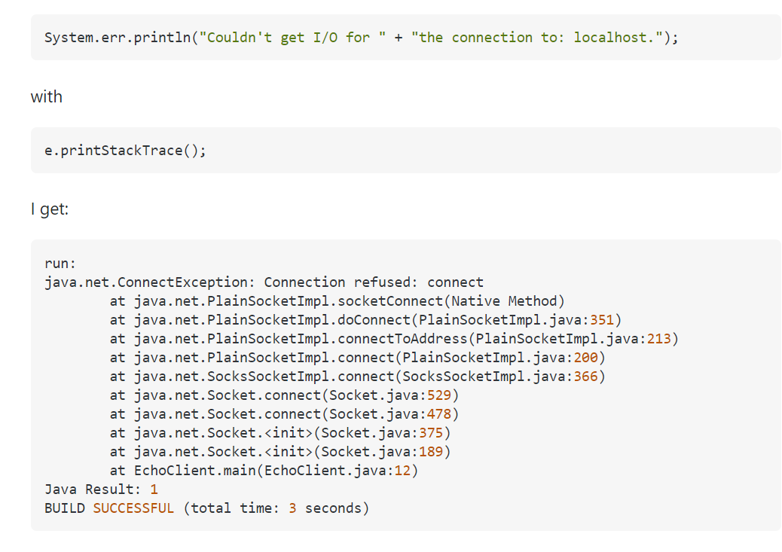
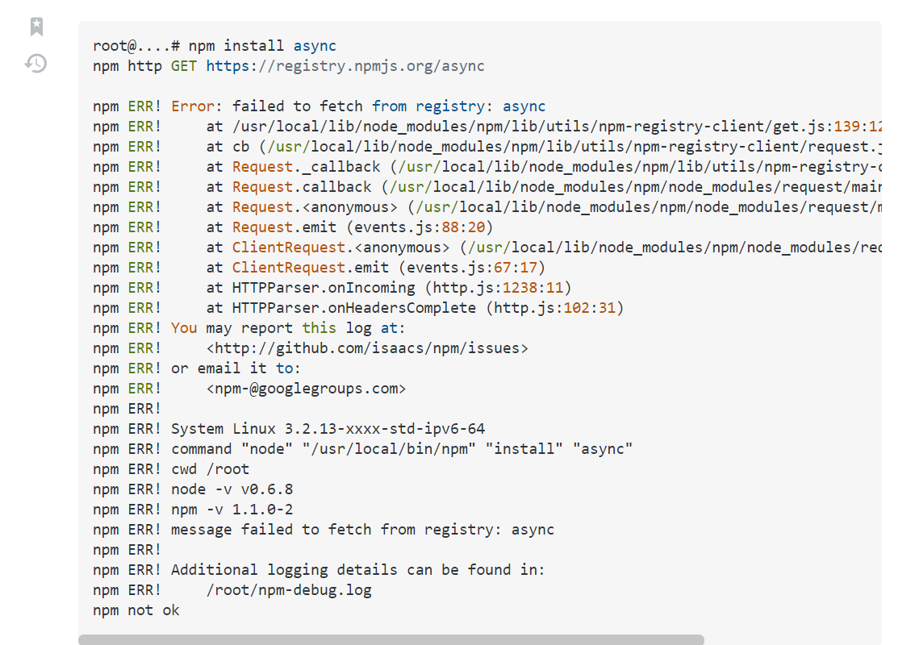
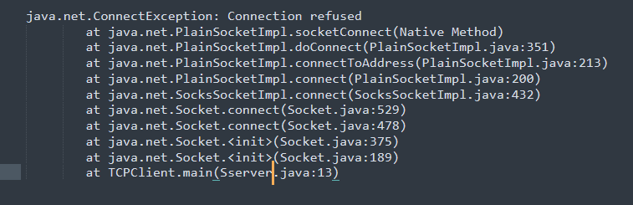
https://stackoverflow.com/questions/7143993/problems-trying-to-implement-java-sockets-example
https://stackoverflow.com/questions/8115126/eclipse-and-tomcat-debugging
99%
95%
https://stackoverflow.com/questions/22917770/unable-to-install-node-modules
Your stack trace error message
10%

Slide 19


Finding similarity among Millions of text documents
No semantic meaning analysis
Finding similarity between two text documents

Slide 20
1. Training time around 24 hours with 300+ GB RAM 2. 30+ GB preprocessed model
300 GB RAM and < 60 sec / query
100 GB
50 GB
Data Collection
Data Processing
Query Pre-processing
Result Generation
1. Data download and extraction (100+GB)
Data exploration
Convert XML files to CSV
Extract code segment from Posts (25GB+)
Extracting different metadata information (10-25 GB)
Term Frequency – Inverse Document Frequency(TF-IDF)
Natural language toolkit (NLTK): for text tokenization, parsing, classification, stemming, tagging and semantic reasoning.
Gensim: Language modeling (Word vector)
Process input query
Generate matched query from pre-processed TF-IDF document
Rank the matched result based on different heuristics
Generate text summarization of the result using GPT-2 pre-trained model

Slide 21
Large raw dataset (>80GB)
Rank Stack Overflow Posts
Offline Batch process
Generate Result
Preprocessed document Index
Server Initialization
Text summarization
Pre-process query
30 min
< 50 sec
Central server
User Query

Slide 22

Methodology explanation
TD-IDF example

Slide 23
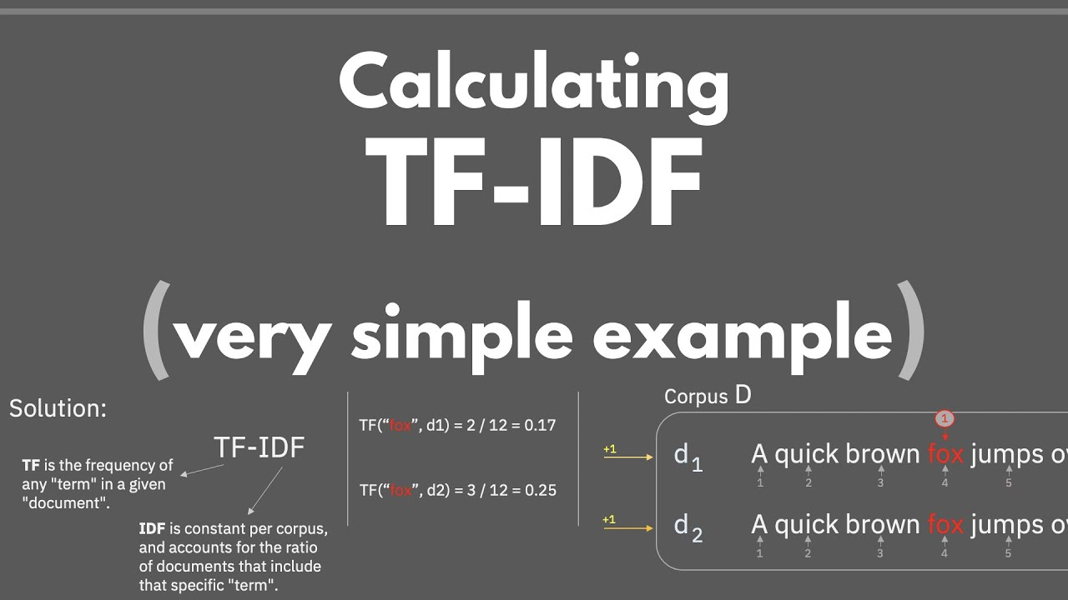

Slide 24
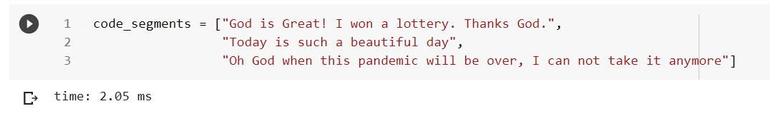
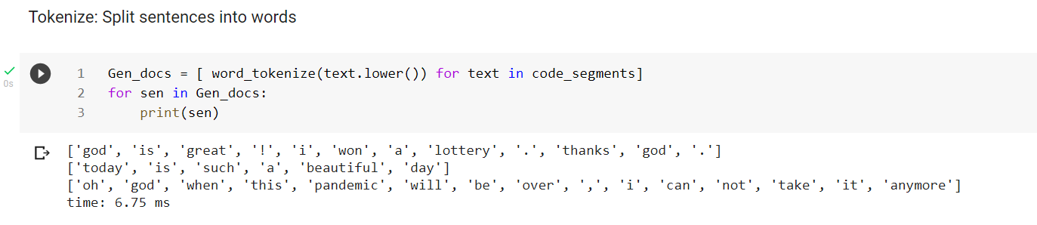
Tokenization
33M code segments (25GB)

Slide 25
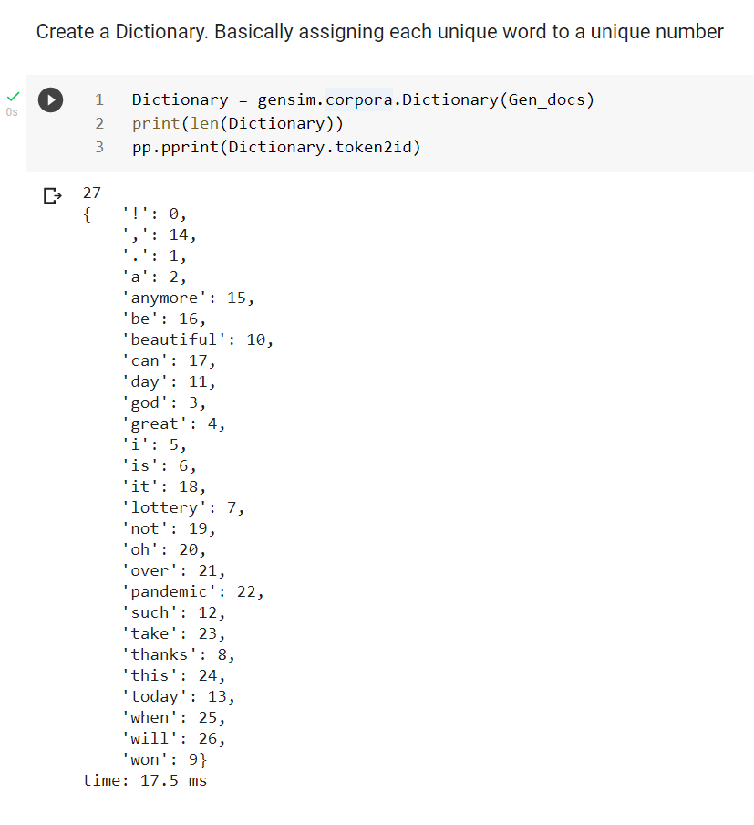
Dictionary
2M unique words in our corpus

Slide 26
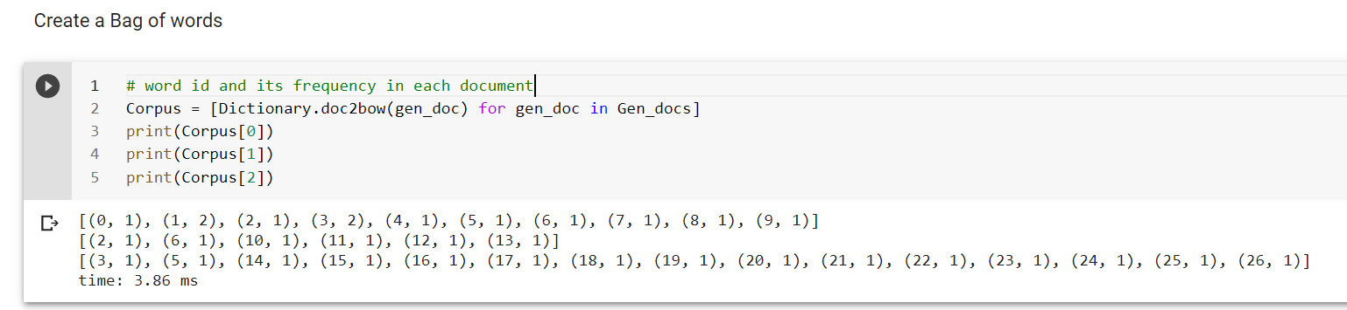
Create a bag of words
Word_id => frequency
Corpus size 33M stack trace

Slide 27
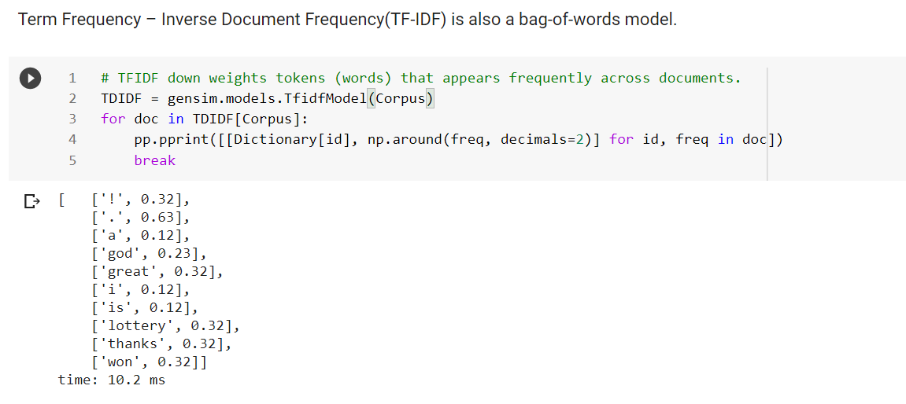
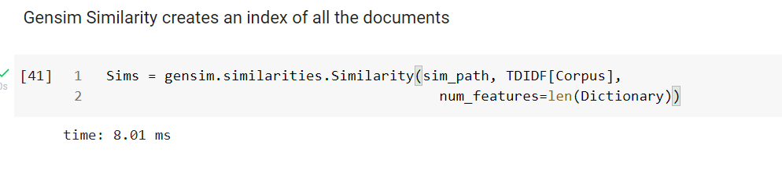
Word index matrix
Requires around 300 GB RAM to load in memory
400 GB of RAM and 24 Hours

Slide 28
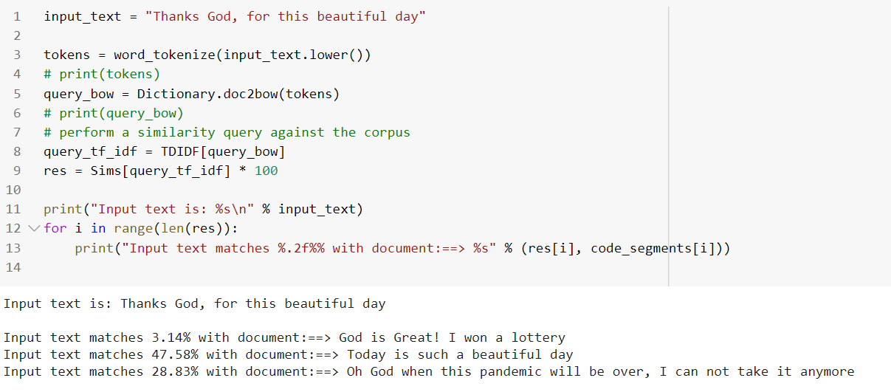
Query Pre-processed Document Index
Generates result within 20s by searching over 33M Posts

Slide 29
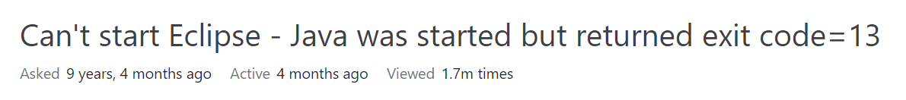
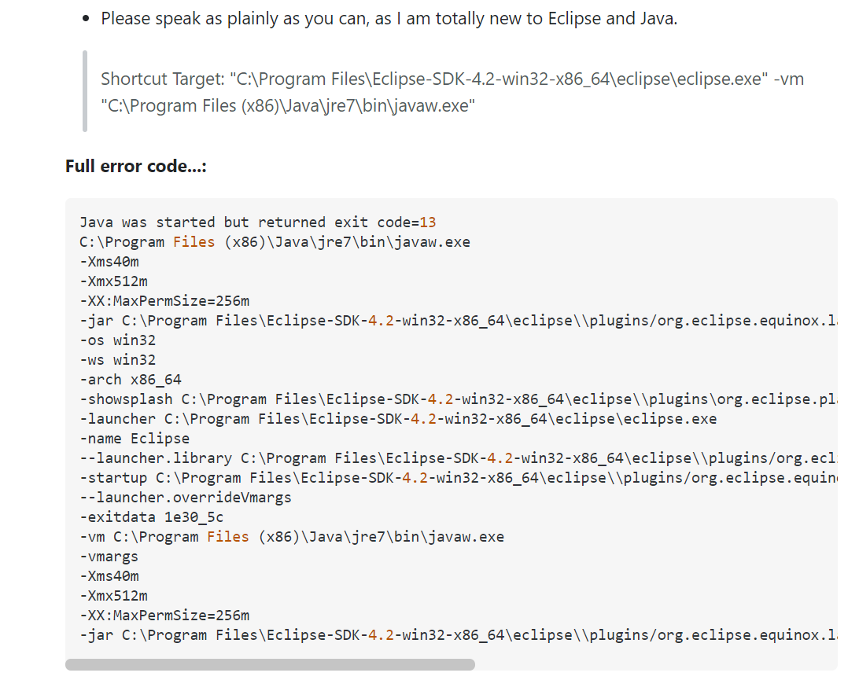
https://stackoverflow.com/questions/11461607/cant-start-eclipse-java-was-started-but-returned-exit-code-13

Slide 30
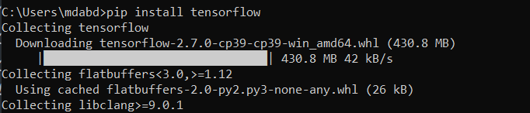
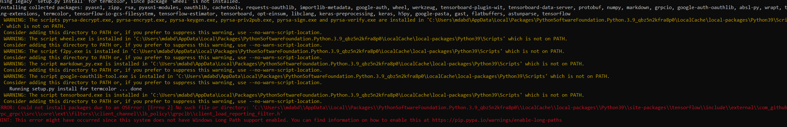

Slide 31
Final Output

Slide 32
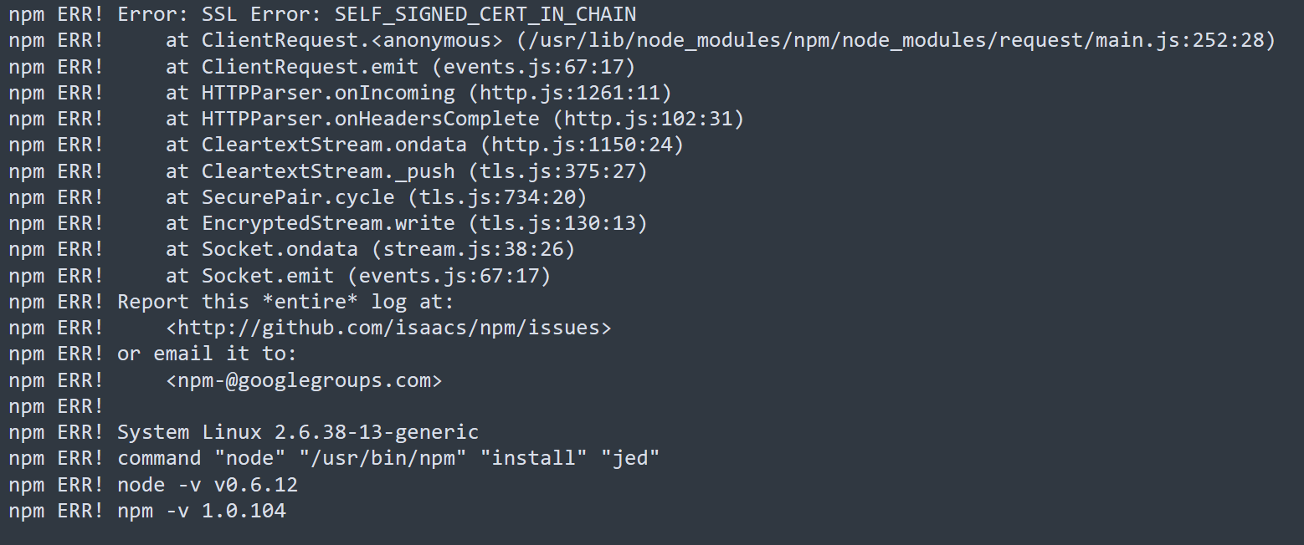
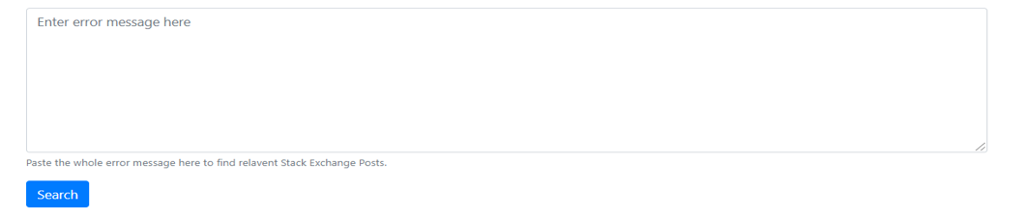
Stack trace of error

Slide 34
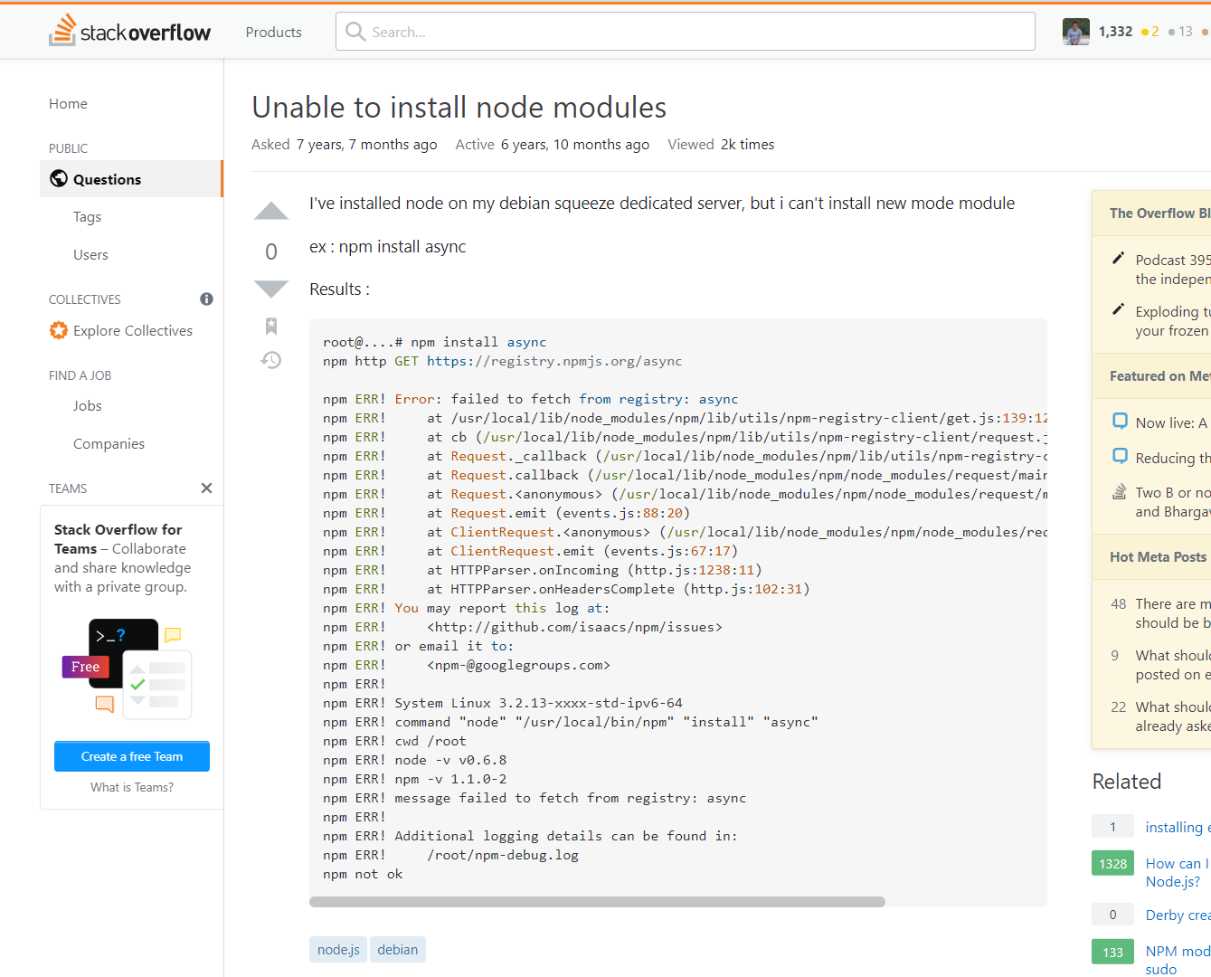

Slide 35
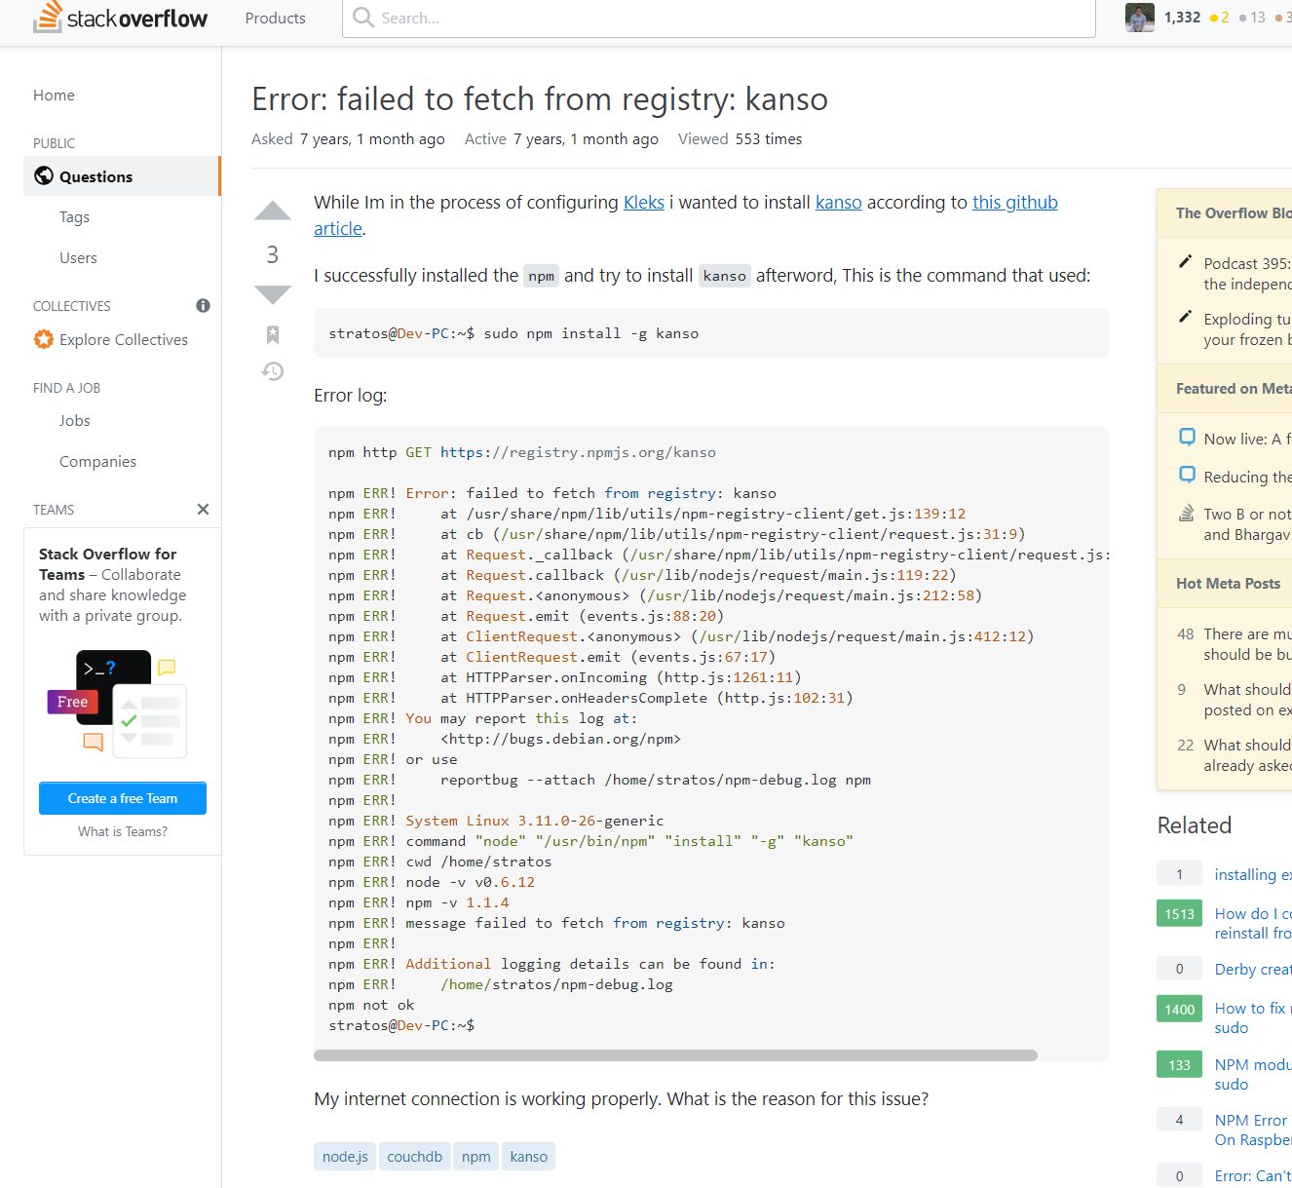

Slide 36
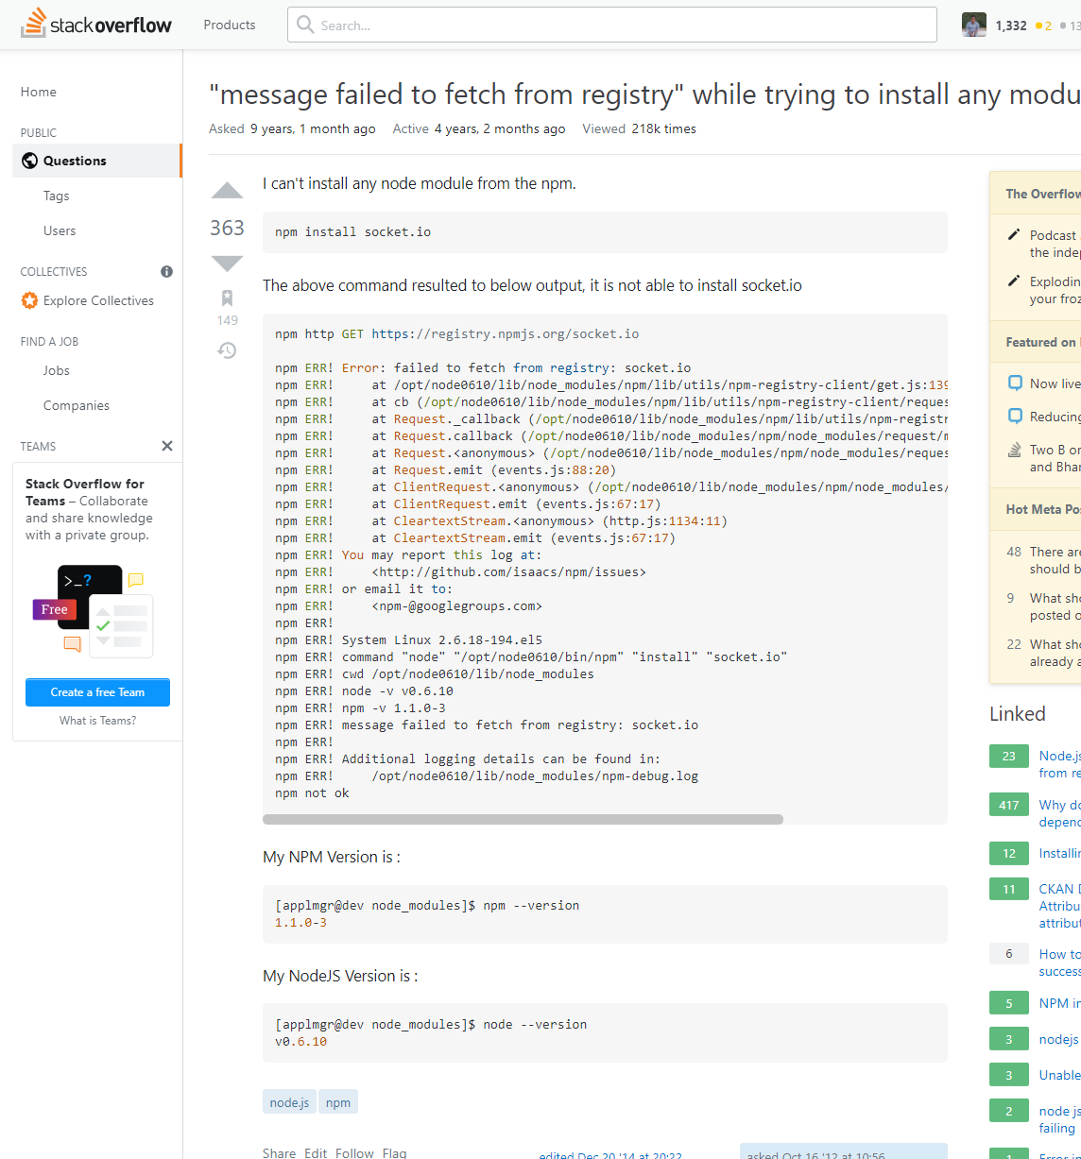

Slide 37


Slide 39
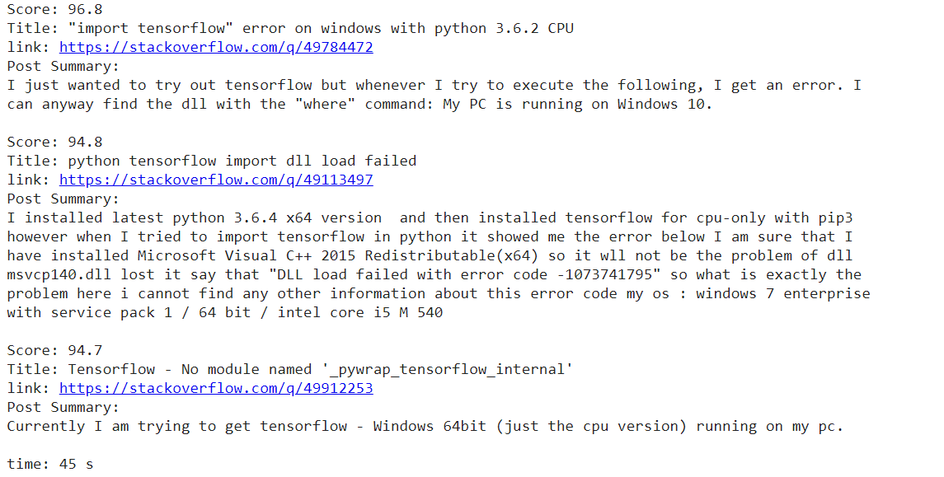

Slide 40
Reflection

Slide 42
Course outcome
Batch jobs
Large scale computation
Spark for NLP
Guest speakers

Slide 43
Computational Challenges
Storage Constraints
Around 80+ GB textual data,
Around 45M stack overflow Posts
33M posts with code segments
Around 2M unique words
I/O limitation
Processing Constraints:
Large jobs taking hours
Need result quick (within 60 second.)
GPU for faster text summarization
Memory Constraints:
Document index takes around 300 GB of RAM

Slide 44
80 hours of batch job processing
300+ GB RAM 30 Min Initialization < 50s0 result generation
Large Data Processing
Offline batch data processing
Real time processing
Data pre-processing and building word document Index
Preprocess query => Find relevant questions => Rank posts => Text summarization

Slide 45


